Slide 1

Introduction to Computer Programming CMP 101 Arrays
Dr. Perihan PEHLIVANOGLU
Biruni University
Department of Computer Engineering
Fall 2022
The rights of the lecture slides belong to Biruni University. It cannot be shared on the internet in any way .

Slide 2
Course content
Introduction to Computers, Programs and Java
Basic Programming
Elections
Mathematical Functions, Characters, and Sequences
MIDTERM
Loops
Methods
One-Dimensional Arrays
Multidimensional Arrays
FINAL

Slide 3

Let's Remember Our Lesson Last Week
In the last lesson, we completed the topic of methods.

Slide 4

This week
In this lecture, we will learn about arrays. They are used as data structures for a list.
In summary, we will learn;
array definition,
initializing the elements of the array,
modifying the elements of the array

Slide 5
Objectives of This Lesson
To describe why arrays are necessary in programming (§7.1).
To declare array reference variables and create arrays (§§7.2.1 and 7.2.2).
To obtain array size using arrayRefVar.length and know default values in an array (§7.2.3).
To access array elements using indexes (§7.2.4).
To declare, create, and initialize an array using an array initializer (§7.2.5).
To program common array operations (displaying arrays, summing all elements, finding the minimum and maximum elements, random shuffling, and shifting elements) (§7.2.6).
To simplify programming using the foreach loops (§7.2.7).
To apply arrays in application development (AnalyzeNumbers, and DeckOfCards) (§§7.3 and 7.4).
To copy contents from one array to another (§7.5).
To develop and invoke methods with array arguments and return values (§§7.6–7.8).
To define a method with a variable-length argument list (§7.9).
To search elements using the linear (§7.10.1) or binary (§7.10.2) search algorithm.
To sort an array using the selection sort approach (§7.11).
To use the methods in the java.util.Arrays class (§7.12).
To pass arguments to the main method from the command line (§7.13).

Slide 6
Arrays

Slide 7

Arrays
Arrays are collections. They are our data structures for lists.
A single array variable can reference a large collection of data.

Slide 8
Arrays
Often you will have to store a large number of values during the execution of a program. Suppose, for instance, that you need to read 100 numbers, compute their average, and find out how many numbers are above the average.
Your program first reads the numbers and computes their average, then compares each number with the average to determine whether it is above the average. In order to accomplish this task, the numbers must all be stored in variables.

Slide 9
Arrays
You have to declare 100 variables and repeatedly write almost identical code 100 times. Writing a program this way would be impractical. So, how do you solve this problem?
An efficient, organized approach is needed. Java and most other high-level languages provide a data structure, the array, which stores a fixed-size sequential collection of elements of the same type. In the present case, you can store all 100 numbers into an array and access them through a single array variable.

Slide 10
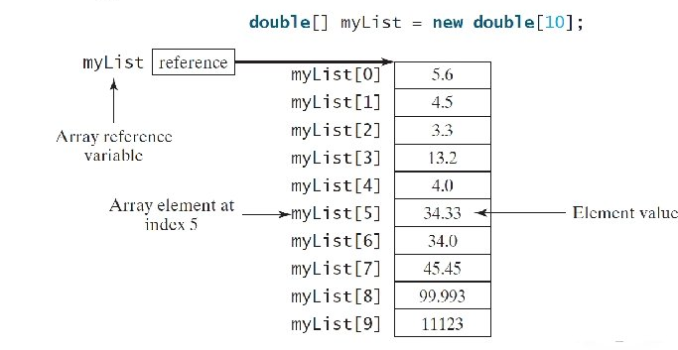
Arrays
Arrays are data structures that hold the same type of data.
Once an array is created, its size is fixed. An array reference variable is used to access the elements in an array using an index.

Slide 11
Arrays
An array is used to store a collection of data, but often we find it more useful to think of an array as a collection of variables of the same type.
Instead of declaring individual variables, such as number0, number1, . . . , and number99, you declare one array variable such as numbers and use numbers[0], numbers[1], . . . , and numbers[99] to represent individual variables.

Slide 12
Declaring Variables as Arrays
datatype[] arrayRefVar;
Example:
double[] myList;
data type arrayRefVar[]; // This style is allowed but not preferred.
Example:
double myList[];

Slide 13
Arrays
Unlike declarations for primitive data type variables, the declaration of an array variable does not allocate any space in memory for the array.
It creates only a storage location for the reference to an array. If a variable does not contain a reference to an array, the value of the variable is null. You cannot assign elements to an array unless it has already been created.

Slide 14
Arrays
After an array variable is declared, you can create an array by using the new operator and assign its reference to the variable with the following syntax:
arrayRefVar = new elementType[arraySize];
This statement does two things:
(1)it creates an array using new elementType[arraySize] and
(2) it assigns the reference of the newly created array to the variable arrayRefVar.

Slide 15
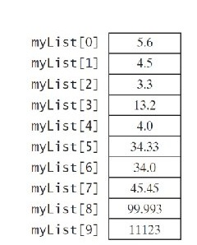
Array Declaration
ArrayRefVar = new datatype[arraySize];
Example:
myList = new double[10];
MyList[0] accesses the first item in the array (index).
MyList[9] accesses the last item in the array.

Slide 16
Creating an Array
Declaring an array variable, creating an array, and assigning the reference of the array to the variable can be combined in one statement as
datatype[] arrayRefVar = new datatype[arraySize];
double[] myList = new double[10];
datatype arrayRefVar[] = new datatype[arraySize];
double myList[] = new double[10];

Slide 17
Array Length
After an array is created, its size is fixed. It cannot be changed later. The following method is used to find the length of the array;
arrayRefVar.length
For example,
myList.length returns 10.

Slide 18
Default Values
When an array is created, its elements are assigned default values.
0 for numeric primitive data types,
'\u0000' for character data types,
false for Boolean data types.

Slide 19
Indexed Variables
Array elements are accessed through array.
These array indexes are 0-based , meaning they start at 0 and end with arrayRefVar.length-1 .
myList holds ten double values and indexes from 0 to 9.
Each element in the array is accessed with an indexed variable and the following syntax:
arrayRefVar[index]

Slide 20
Indexed Variables
Once an array is created, an indexed variable can be used in the same way as a regular variable.
For example,
from myList[0] and myList[1] to myList[2].
myList[2] = myList[0] + myList[1]

Slide 21
Initializing Arrays
Define, create, initialize array in one step:
double[] myList = {1.9, 2.9, 3.4, 3.5};
It declares, creates, and initializes the array myList with four elements, which is equivalent to the following statements:
double[] myList = new double[4];
myList[0] = 1.9;
myList[1] = 2.9;
myList[2] = 3.4;
myList[3] = 3.5;

Slide 22
Initializing Arrays
double[] myList = {1.9, 2.9, 3.4, 3.5};
The short spelling above is actually equivalent to the following operations:
double[] myList = new double[4];
myList[0] = 1.9;
myList[1] = 2.9;
myList[2] = 3.4;
myList[3] = 3.5;

Slide 23
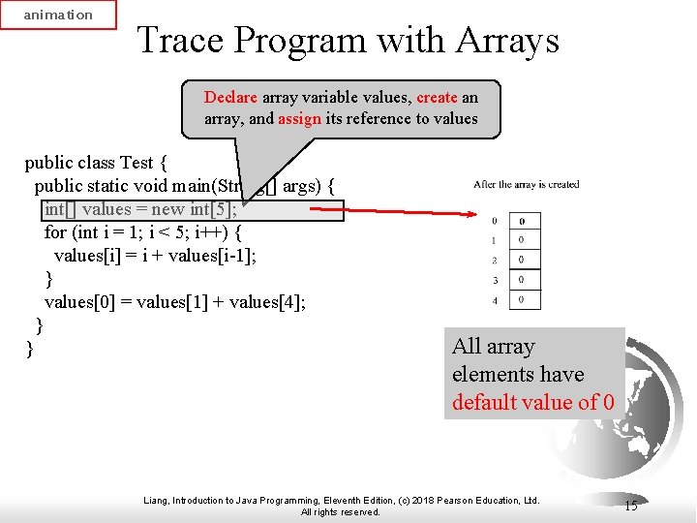
Program with Arrays

Slide 24
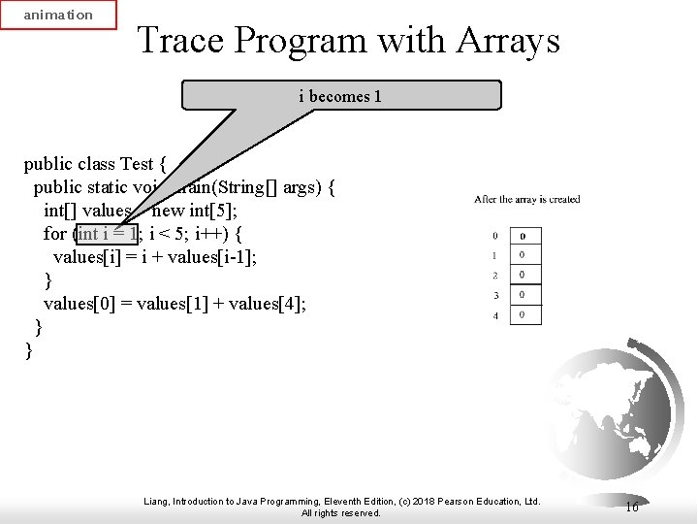
Program with Arrays

Slide 25
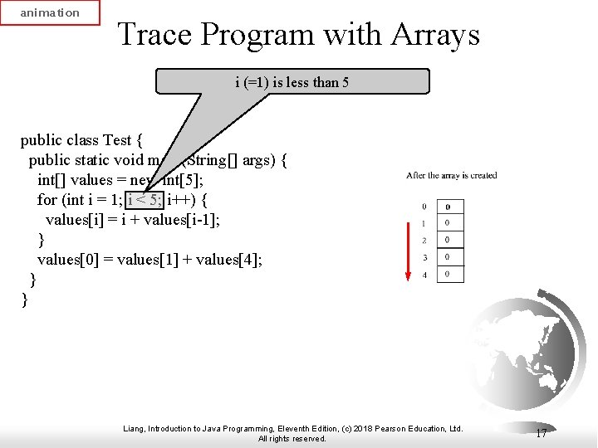
Program with Arrays

Slide 26
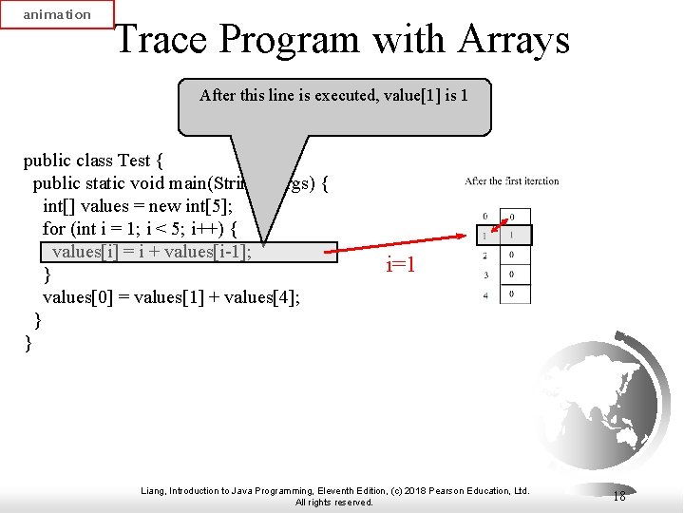
Program with Arrays

Slide 27
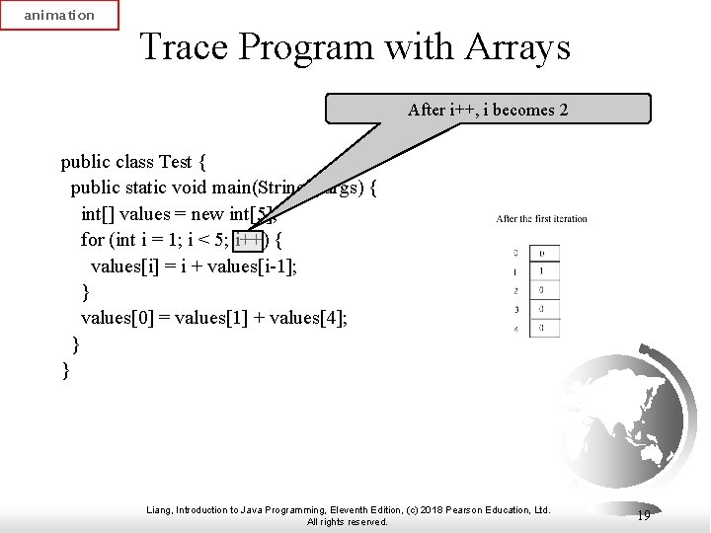
Program with Arrays

Slide 28
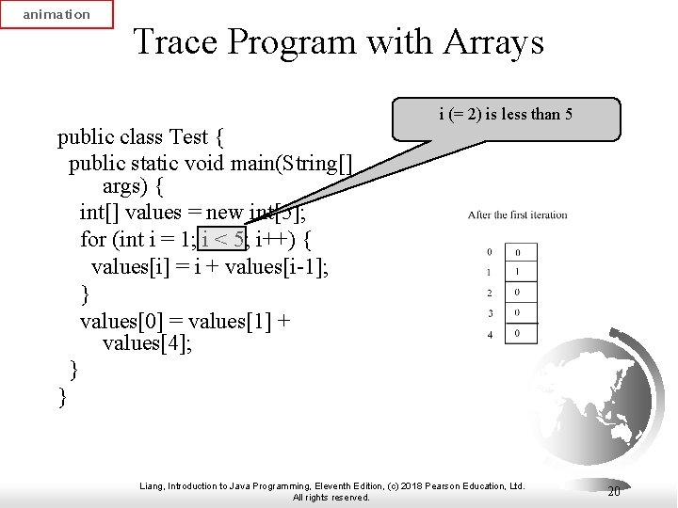
Program with Arrays

Slide 29
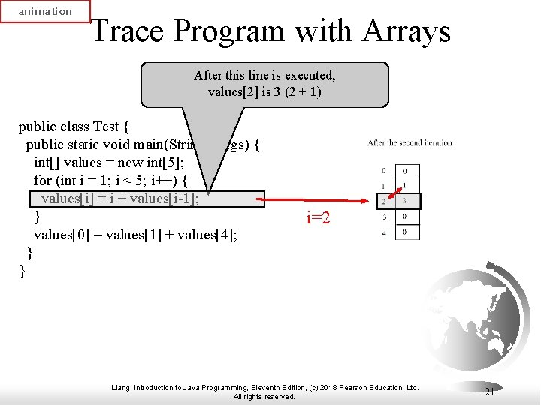
Program with Arrays

Slide 30
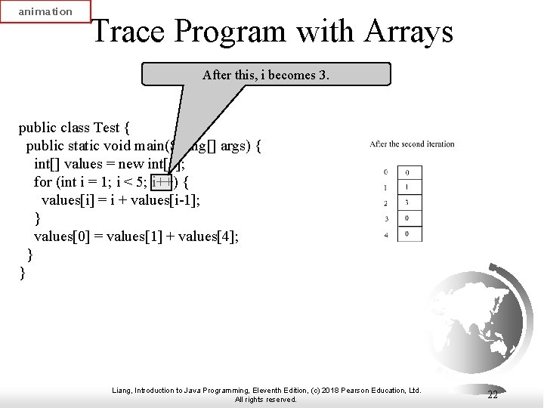
Program with Arrays

Slide 31
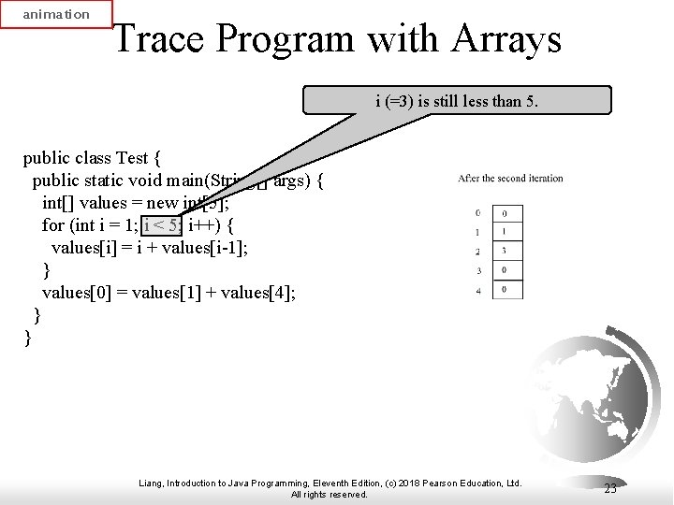
Program with Arrays

Slide 32
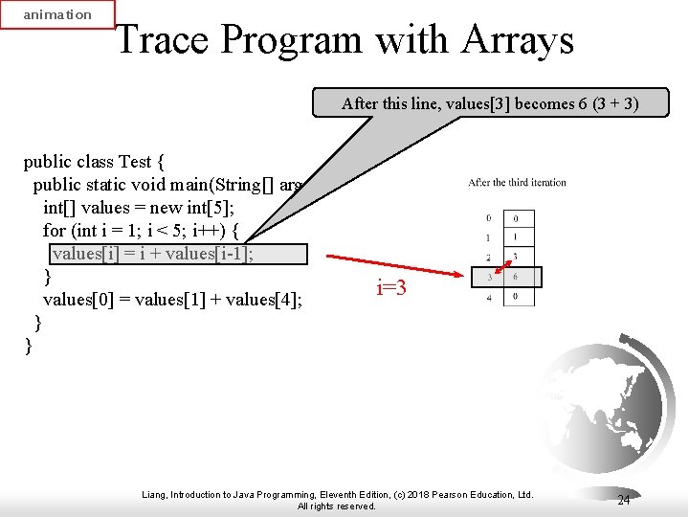
Program with Arrays

Slide 33
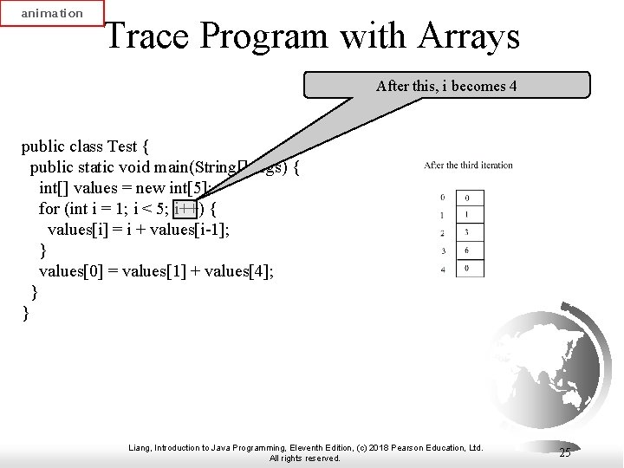
Program with Arrays

Slide 34
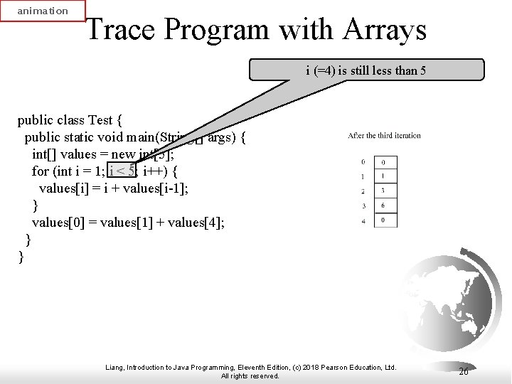
Program with Arrays

Slide 35
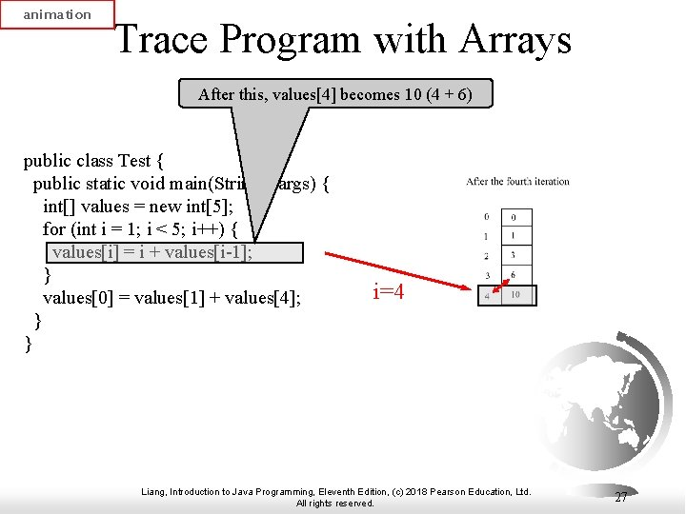
Program with Arrays

Slide 36
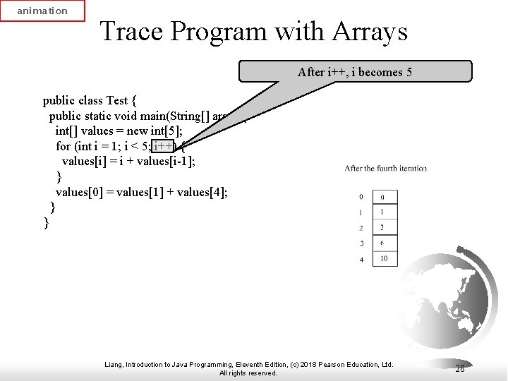
Program with Arrays

Slide 37
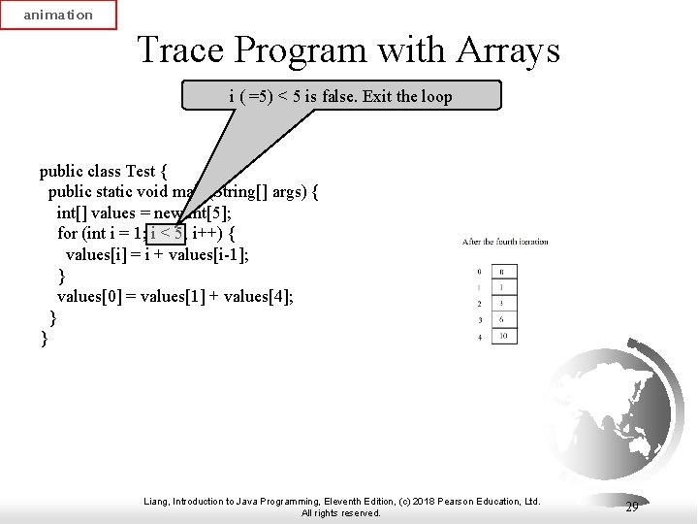
Program with Arrays

Slide 38
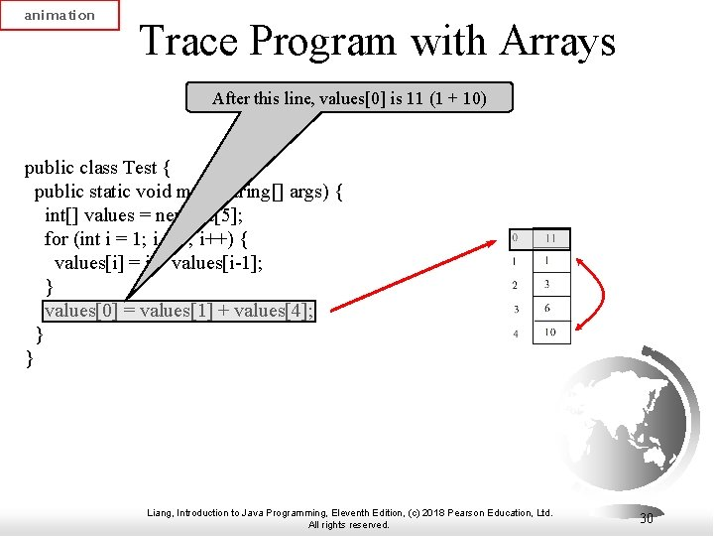
Program with Arrays

Slide 39
Operations with Arrays
(Initializing arrays with input values)
(Initializing arrays with random values)
(Printing arrays)
(Adding all elements)
(Find the largest element)
(Find the index of the largest element – also the smallest index)
( Random shuffle )
( Changing elements )

Slide 40
Initializing arrays with input values
java.util.Scanner input = new java.util.Scanner(System.in);
System.out.print("Enter " + myList.length + " values: ");
for (int i = 0; i < myList.length; i++)
myList[i] = input.nextDouble();

Slide 41
Initializing arrays with random values
for (int i = 0; i < myList.length; i++)
{
myList[i] = Math.random() * 100;
}

Slide 42
Printing arrays
for (int i = 0; i < myList.length; i++)
{
System.out.print(myList[i] + " ");
}

Slide 43
Adding all elements
double total = 0;
for (int i = 0; i < myList.length; i++)
{
total += myList[i];
}

Slide 44
Finding the largest element
double max = myList[0];
for (int i = 1; i < myList.length; i++)
{
if (myList[i] > max) max = myList[i];
}

Slide 45
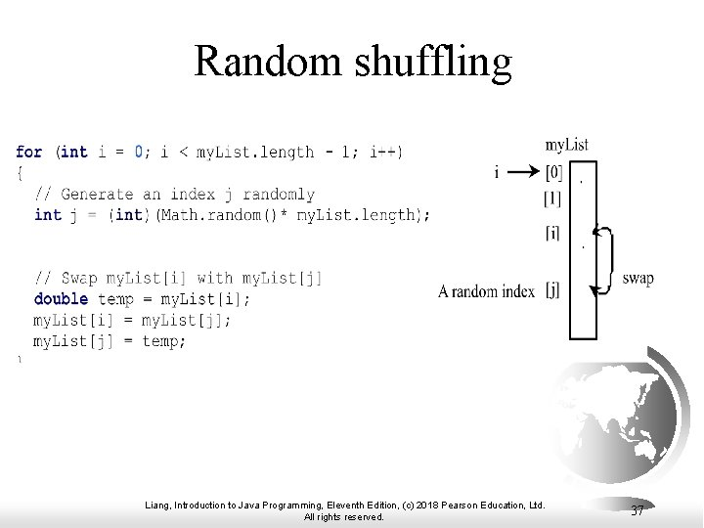
Random shuffle

Slide 46
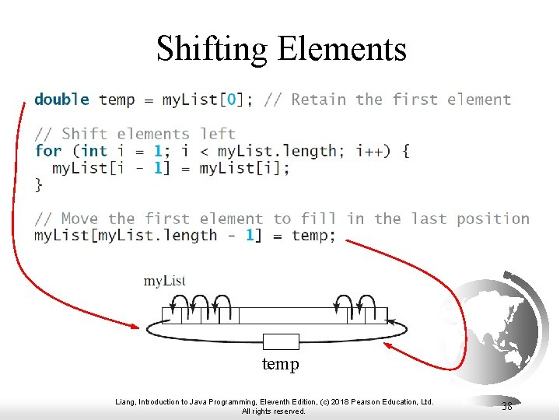
Changing elements

Slide 47
Foreach loop
JDK 1.5 introduced a new for loop that allows you to traverse the entire array.
You can print all the elements in the array sequentially without using an array variable:
for ( double value : myList)
System. out .println( value );
In general, the syntax
for (elementType value : arrayRefVar) {
// Process the value
}

Slide 48

A Simple Program
Let the user enter numbers from the console into a 10-element array. Then calculate both the sum and the average of the array and print it on the console.

Slide 49
Let's Write a Simple Program - 1
Algorithm:
Read 10 numbers from the console into the array in a loop and calculate the sum of the array elements
Calculate mean out of loop

Slide 50
Let's Write a Simple Program - 1
import java.util.*;
public class Arrays {
public static void main(String[] args ) {
int [] array = new int [10];
// Read 10 numbers from the console into the array in a loop and calculate the sum of the array elements
Scanner input = new Scanner(System. in );
int total =0;
for ( int i =0; i < 10; i ++)
{
System. out .println( "Enter the " + i + "th element of the array: " );
array [ i ]= input .nextInt();
sum = sum + array [ i ];
}
// Calculate the mean outside the loop
}
}

Slide 51
Let's Write a Simple Program - 1
Enter the 0th element of the array:
10
Enter the 1st element of the array:
11th
Enter the 2nd element of the array:
12
Enter the 3rd element of the array:
13
Enter the 4th element of the array:
14
Enter the 5th element of the array:
15
Enter the 6th element of the array:
16
Enter the 7th element of the array:
17
Enter the 8th element of the array:
18
Enter the 9th element of the array:
19
Elements of the array:
10
11th
12
13
14
15
16
17
18
19
Sum of array elements: 145 average: 14.5
import java.util.*;
public class Arrays {
public static void main(String[] args ) {
int [] array = new int [10];
// Read 10 numbers from the console into the array in a loop and calculate the sum of the array elements
Scanner input = new Scanner(System. in );
int total =0;
for ( int i =0; i < 10; i ++)
{
System. out .println( "Enter the " + i + "th element of the array: " );
array [ i ]= input .nextInt();
sum = sum + array [ i ];
}
// Calculate the mean outside the loop
double average = total /10.0;
System. out .println( "Elements of array: " );
for ( int element : array )
System. out .println( element );
System. out .println( "Sum of array elements: " + sum + " average: " + average );
}
}

Slide 52

Homework - 1
Let the user enter data from the console into a 10-element array. Then calculate the number of elements of the array greater than 20 and print it on the console.

Slide 53
Next week
We will learn the topic of multidimensional arrays.

Slide 54

Application
Arrays

Slide 55
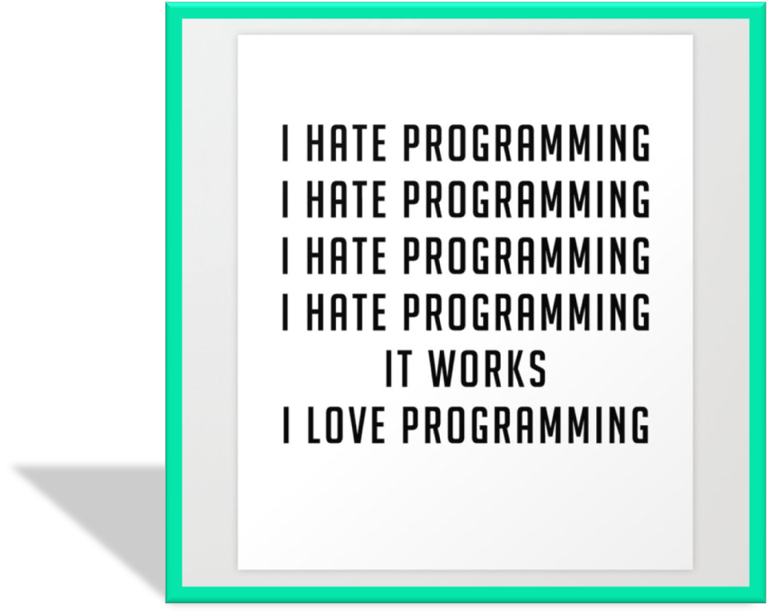
Development in CMP 101

Slide 56





Happy birthday
Love, health, happiness and success be with you in the new year.
2023

Slide 57
Summary
We learned about the arrays.
Next week we will learn about multidimensional arrays.
The questions at the end of the chapter are good. Work on these. Examine the topics that you do not understand in open sources.

